Slide 1
Shell Bootcamp 2024 3 Reflections for Week 1
Mantra Jain
Date : 30-Aug-2024

Slide 2
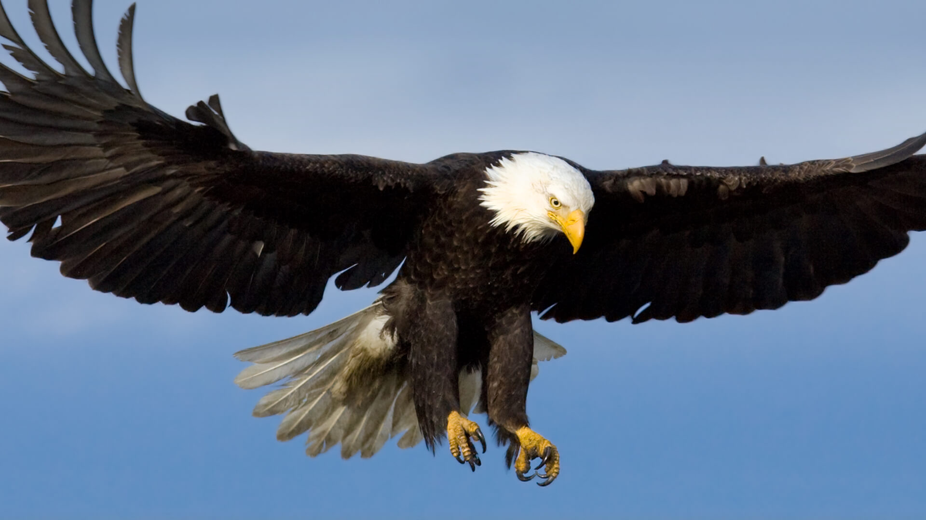
About Me
Please share a phrase that represents
your motto in life
“Dream Big,
Work Hard,
Stay Humble”

Slide 3

My learnings from this week!

Slide 4
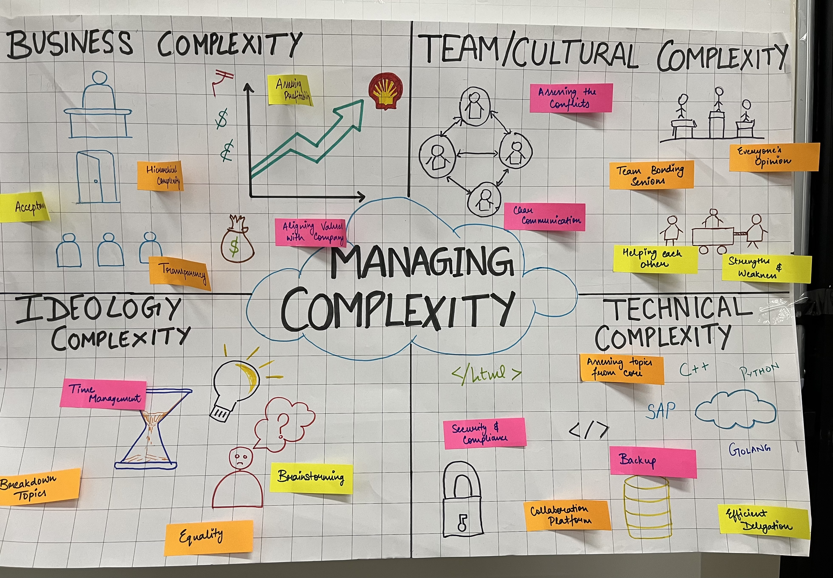
Learning 1 | My takeaways
Details of the learning:
Emotional intelligence: It refers to the ability to recognize, understand, manage, and utilize emotions effectively in oneself and in interactions with others.
Active Listening: Techniques for truly understanding and responding to the emotions and perspectives of others.
Fixed Mindset: Pessimism
Growth Mindset: Optimism
E-Mail Writing: Plan Organize Write Edit Review (POWER)
[Add a graphic that provides evidence of what you learned]

Slide 5
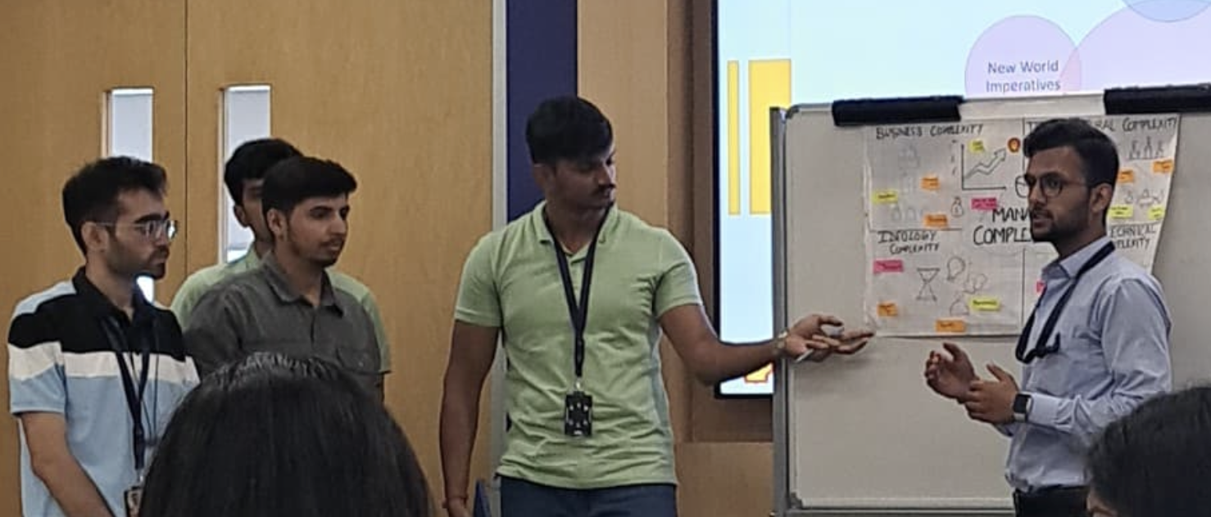
Learning 2 | My takeaways
Please share (in your own words) details of the learning.
Stakeholder Management.
Types of person to to form a successful team.
Stakeholder Management can be implemented in the Energy sector in Community engagement, Regulatory compliance, Strategic partnerships.

Slide 6

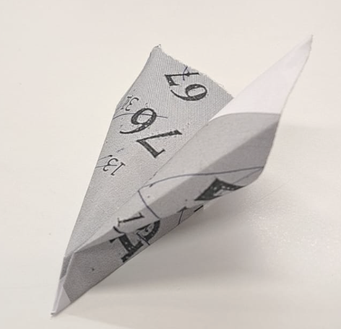
Learning 3 | My takeaways
Please share (in your own words) details of the learning.
Requirement Analysis, Elicitation, Management, Traceability.
Scrum has high velocity, adaptability and is customer centric.
Improved Risk Management, Better Stakeholder Engagement, Improved Safety and Compliance.

Slide 7

Relevance of learnings for my organization

Slide 8
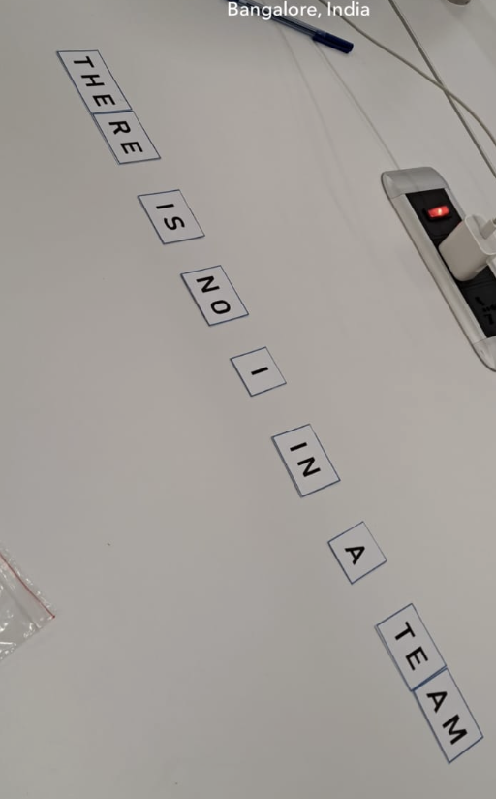
Learning 1 | Relevance for Shell
How I feel Shell implements this learning?
Integrate Training into Daily Work.
Promote Continuous Learning.
Create a Culture of Soft Skills.
How I feel Shell benefits from this learning?
Enhanced Teamwork and Collaboration
Better Leadership and Management
Improved Conflict Management
Strengthened Organizational Culture

Slide 9
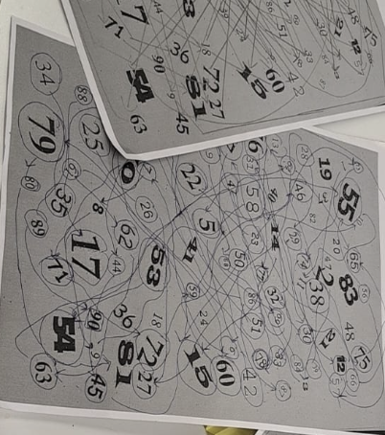
Learning 2 | Relevance for Shell
How I feel Shell implements this learning ?
Monitor and Evaluate Effectiveness
Foster a Stakeholder Management Culture
How I feel Shell benefits from this learning ?
Better Decision-Making
Enhanced Compliance and Regulatory Adherence
Competitive Advantage

Slide 10
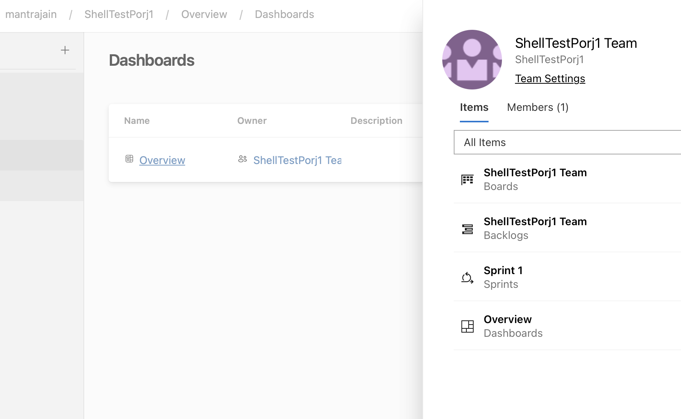
Learning 3 | Relevance for Shell
How I feel Shell implements this learning (in your own words)
Process Efficiency
Foster Agile Culture
Track Metrics: Use Agile metrics (e.g., velocity, burn-down charts) to monitor progress and performance.
How I feel Shell benefits from this learning ?
Leverage Technology
Scale Agile Practices
Improved Collaboration

Slide 11

Challenges in implementing learning

Slide 12
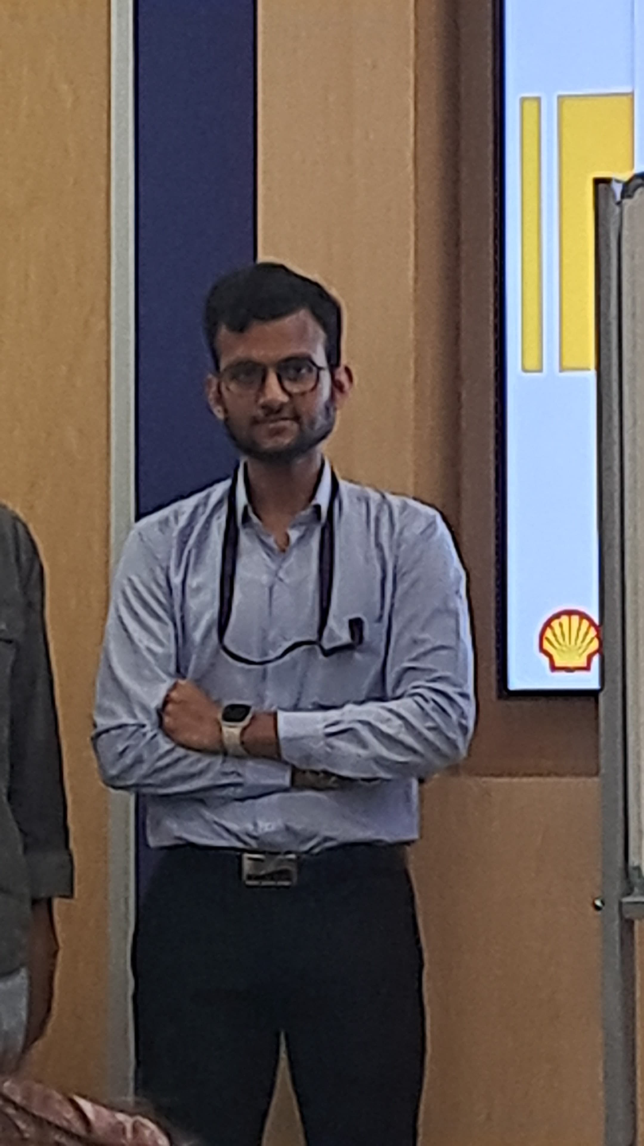
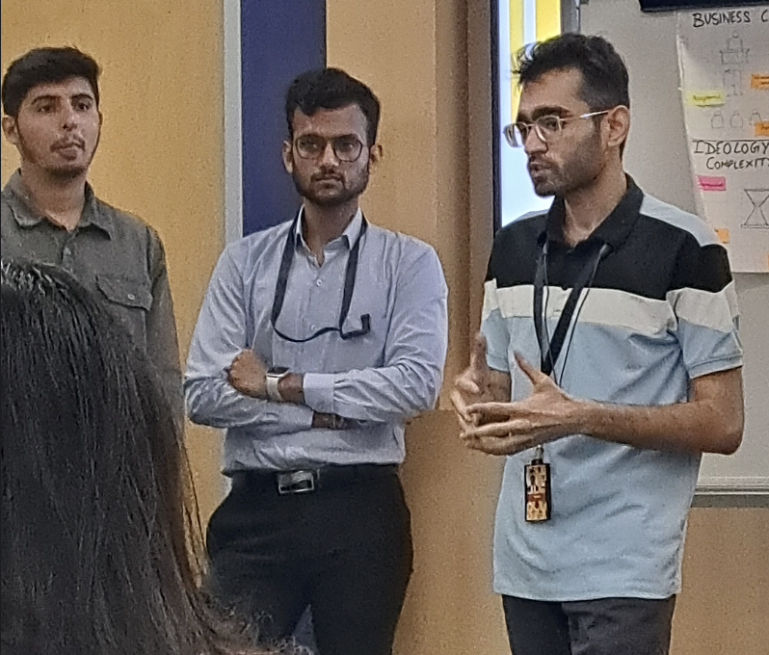
Challenge faced while implementing Learning 1
What were the challenges I faced while implementing Learning 1 and my plan to overcome them
1.Accepting new culture
2. Resistance to Change
3. Fear of Judgment
Solution:
Use interactive techniques such as role-playing, group discussions.
Gamification: Introduce gamified elements such as quizzes

Slide 13
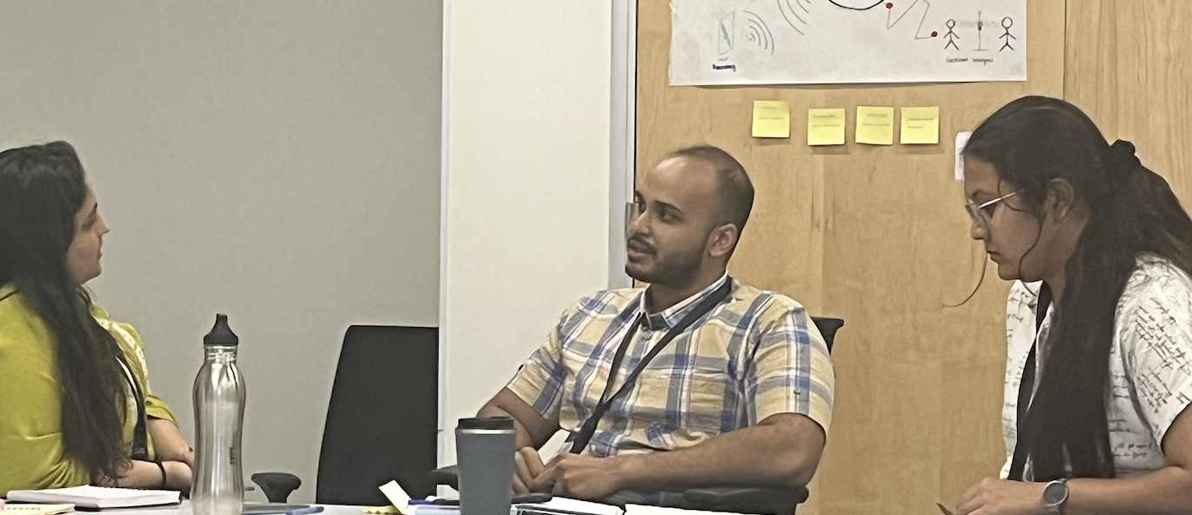
Challenge faced while implementing Learning 2
What were the challenges I faced while implementing Learning 2 and my plan to overcome them
Applying Theory to Practice
Cultural Differences
Solution:
Role-Playing: Conduct role-playing exercises where participants simulate stakeholder.
Templates and Tools: Provide templates for mapping strategies to help us apply what we have learned.

Slide 14
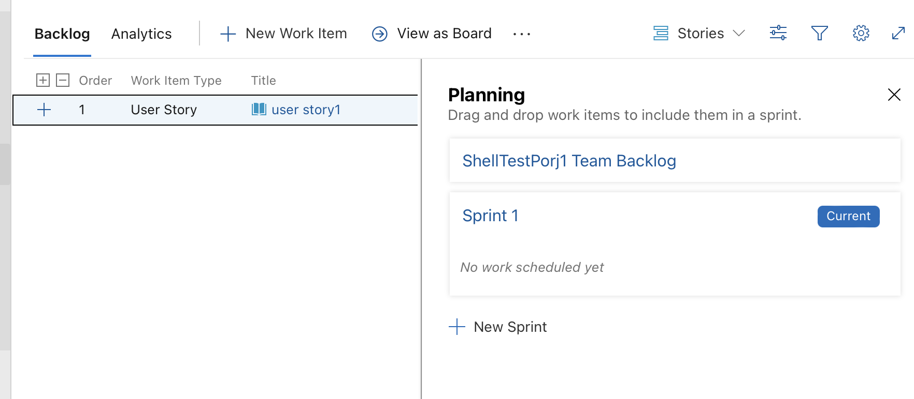
Challenge faced while implementing Learning 3
What were the challenges I faced while implementing Learning 3 and my plan to overcome them
Applying Theory to Practice.
Adapting to New Tools and Techniques.
Balancing Agile with Organizational Structure
Solution:
Peer Learning
Simulations
Regular Reviews

Slide 15

Action Plan

Slide 16
My Action Plan for this Week
Actions
Timeline
Status
Mentoring and Coaching: Provide ongoing mentoring and coaching to support the practical implementation of Agile practices.
Visual Aids: Use Agile boards, charts, and visual models to illustrate key principles and practices.
Preparation and Planning
Assess Needs: Identify participant challenges and skill levels.
Develop Materials: Create training resources, including visual aids and practical exercises.
Made Account on Azure Agile and implemented Epics, Features and Tasks.

Slide 17

Learning is also Fun!

Slide 18
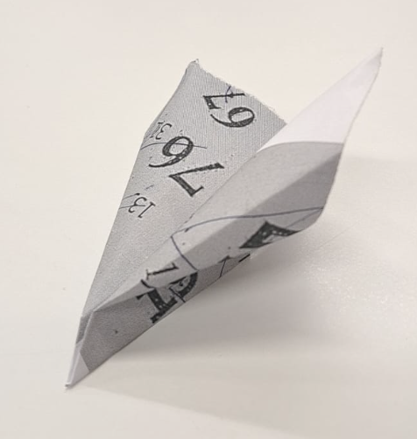
Learning is also Fun!
Please share how ”Your” learning was fun this week
Ice Breakers: Started with fun ice breakers that helped us to get to know each other and feel more comfortable.
Dance of colleagues was quite funny.

Slide 19

Summary
Importance of topics of upcoming week
Burnup Charts
Burndown Charts
Kanban
Connectivity of topics from current week
Development
Q/A
Staging
Production

Slide 20
Thank You

